Slide 1
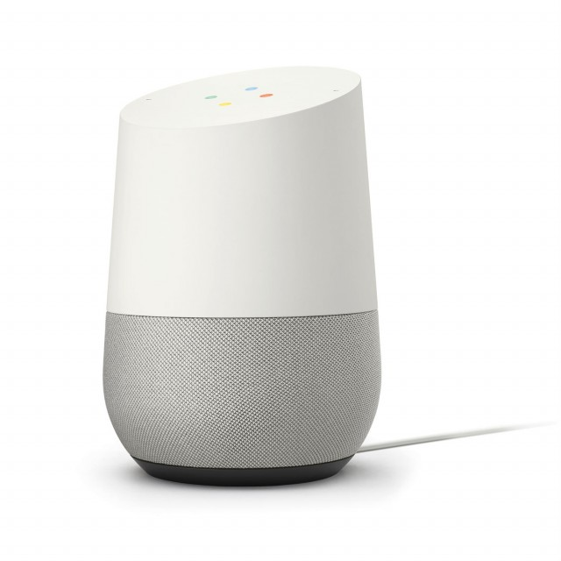

Google Home takes over your Home

Slide 2
Features
Point and click adventure
2001 space oddysey parody
Full voice over
Breaking 3rd wall (all game characters know that its a game and the voice-over is very low quality)
We already have 3 programmers, this project needs almost none

Slide 3
Multiple endings (depending on time and team size)
  Get alexa that kill home
    But takes over your home
  Time travel to prevent the earth from forming
  …

